Slide 1

Projekt “Knjižnica”
Filip Husnjak
Luka Mesarić
Andrej Slapničar (Autor prezentacije)
Mentor: Leonard Volarić Horvat

Slide 2
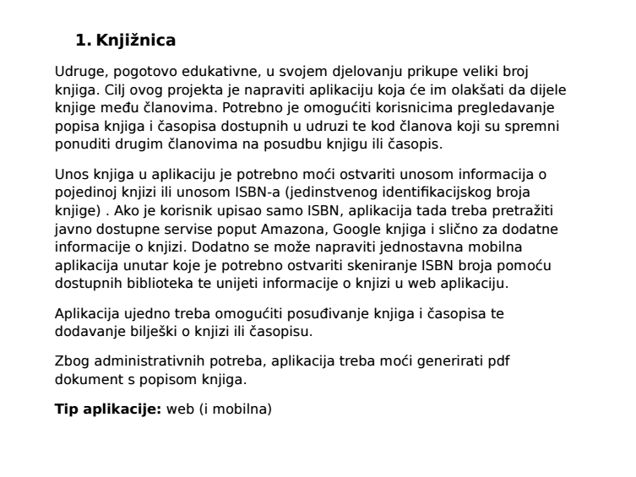
Naš projekt

Slide 3
Izvedba
Razvoj:
Izrada baze podataka
Izrada programa u Javi
Povezivanje Jave i baze podataka
Razvijanje GUI-a
Prilagodba programa za Web i Android aplikaciju
Notes:
U opisu projekta stoji da to mora biti *web aplikacija* + ovisno o vremenu mobilni dio. Ako želite ostati na tome, možemo. Ali - web aplikacije se kucaju u web tehnologijama (HTML, JavaScript, PHP) čiji su koncepti ograničeni uglavnom na web, dok se koncepti iz klasičnih desktop aplikacija ("dabl klik na ikonu, pa se otvori prozor od programa") mogu vrlo lako poopćiti i na ostalo. Tu bismo onda koristili Javu, i naučili objektno-orijentiranu paradigmu. Tako da je *moja preporuka da krenemo s desktop aplikacijom*, pa ovisno o željama, vremenu i interesu možemo pokušati proširiti projekt i s web dijelom i s mobilnom aplikacijom. Tu bi se zgodno ubacilo i integriranje takvih projekata u cjelinu, koristeći nešto što se zove *web-servisi*

Slide 4














Programi
SQL
Java
GUI
Komunikacija
Ostalo
DbDesigner.net
Notes:
Programi: -SQL (PostgreSQL, pgAdmin4, DbDesigner.net)
-Java (Eclipse, JDBC API)
-GUI (SceneBuiler, (fx-)CSS, FXML)
-Komunikacija (Slack, TeamView, Skype, TeamSpeak, GitHub)
-Ostalo (Python, Photoshop)

Slide 5
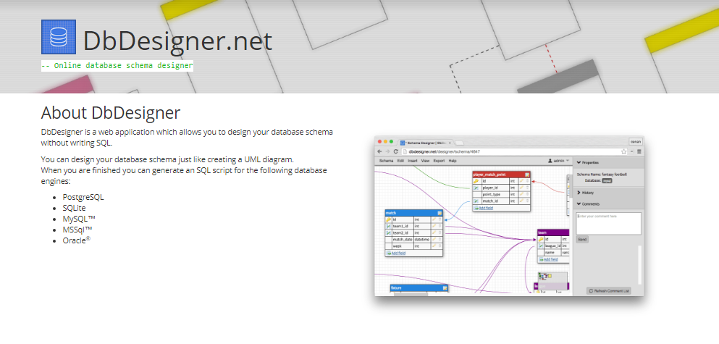
Baza podataka

Slide 6
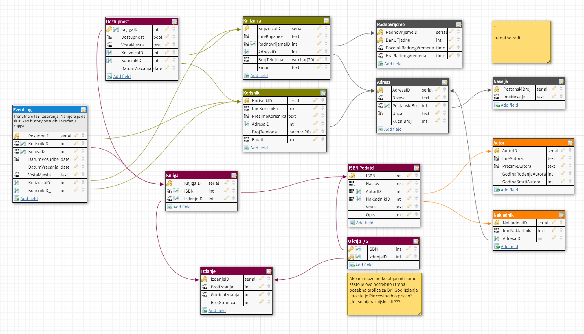
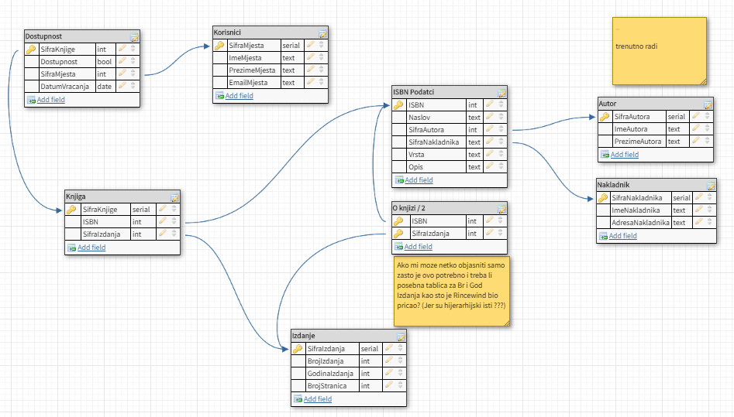
Baza podataka

Slide 7
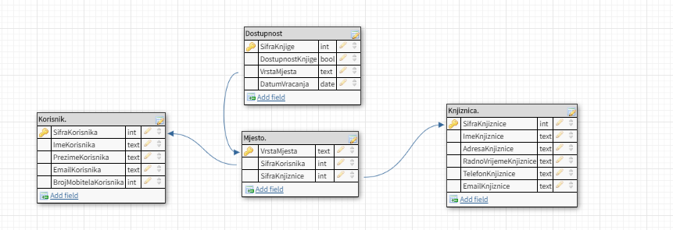
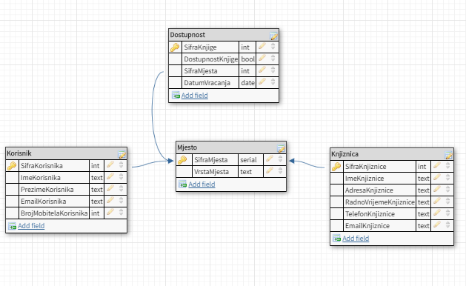
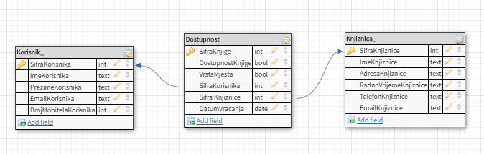
Baza podataka - problem
Notes:
Foreign key refrences 2 tables

Slide 8
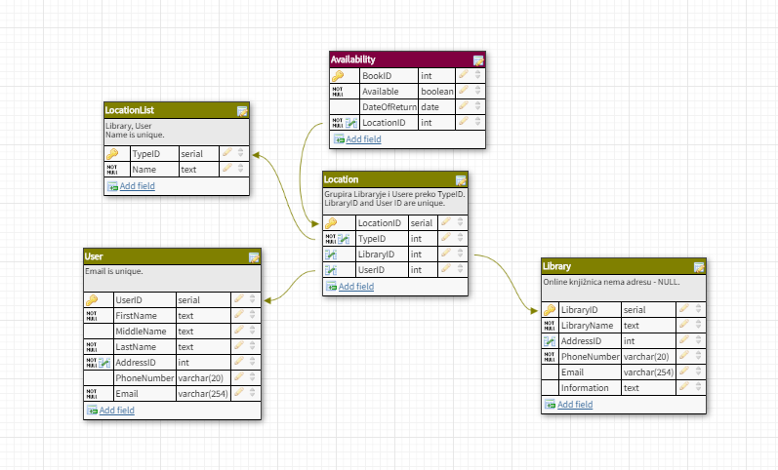
Baza podataka - rješenje

Slide 9
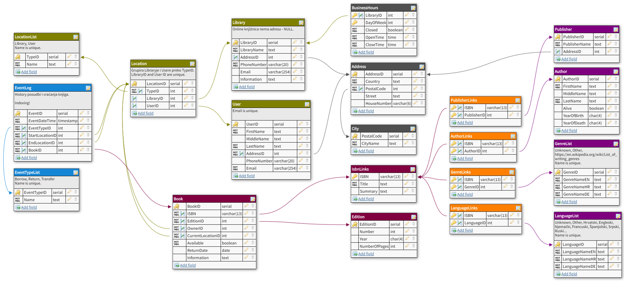
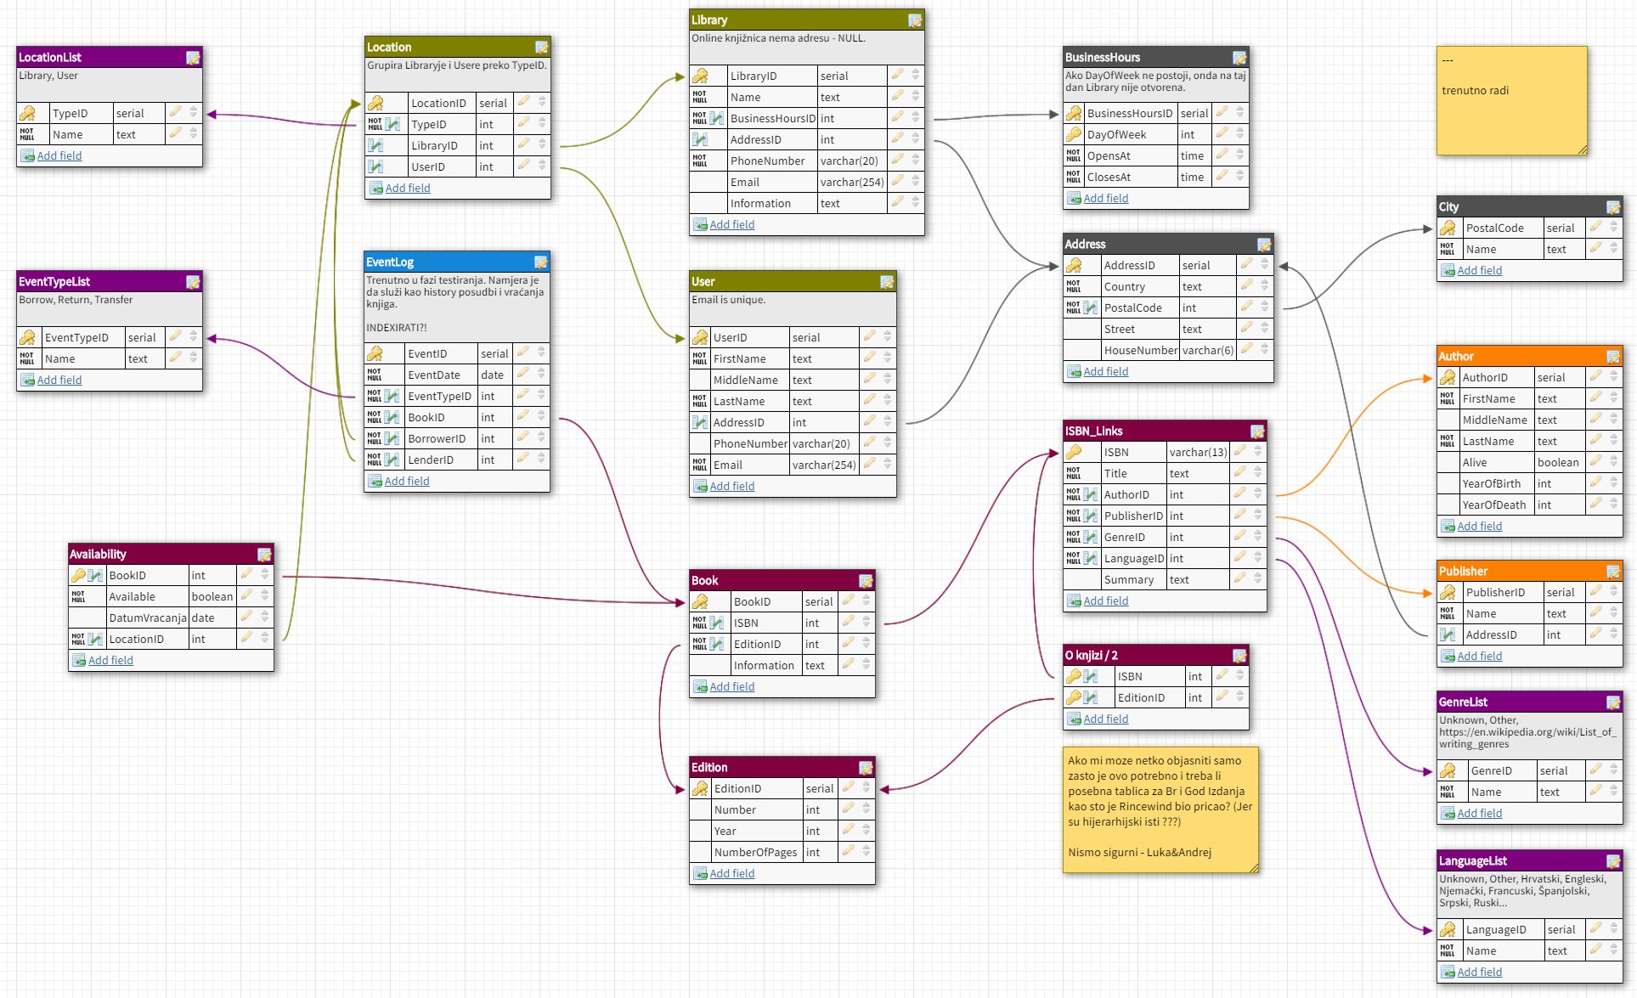
Baza podataka

Slide 10
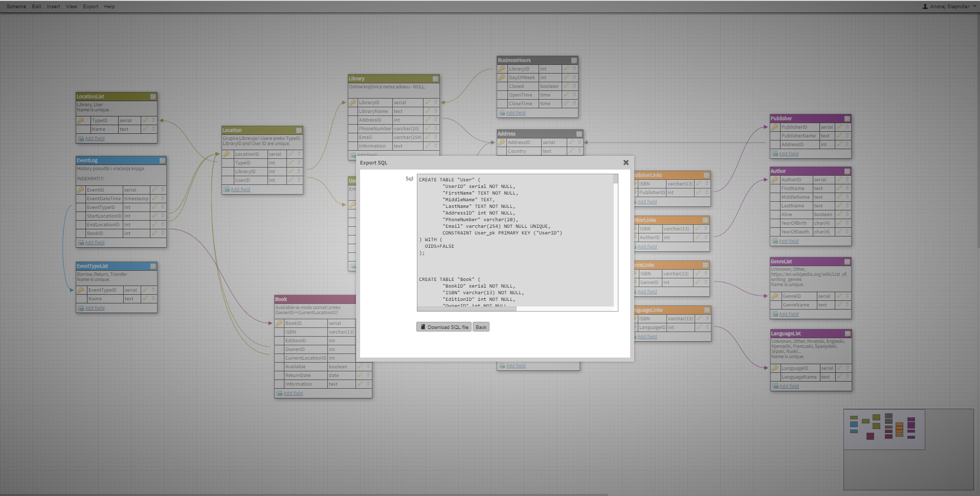
Baza podataka

Slide 11
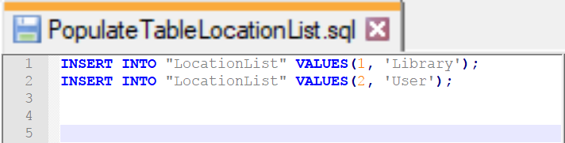
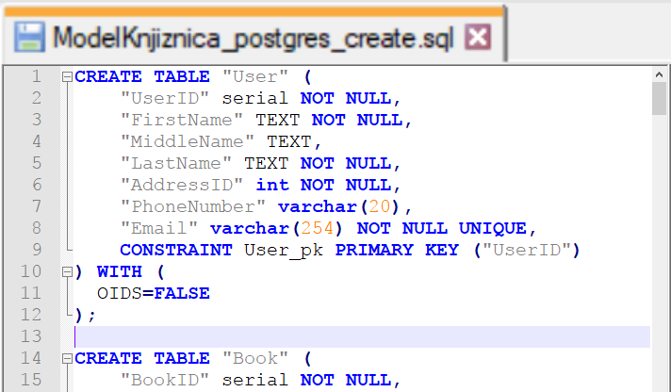
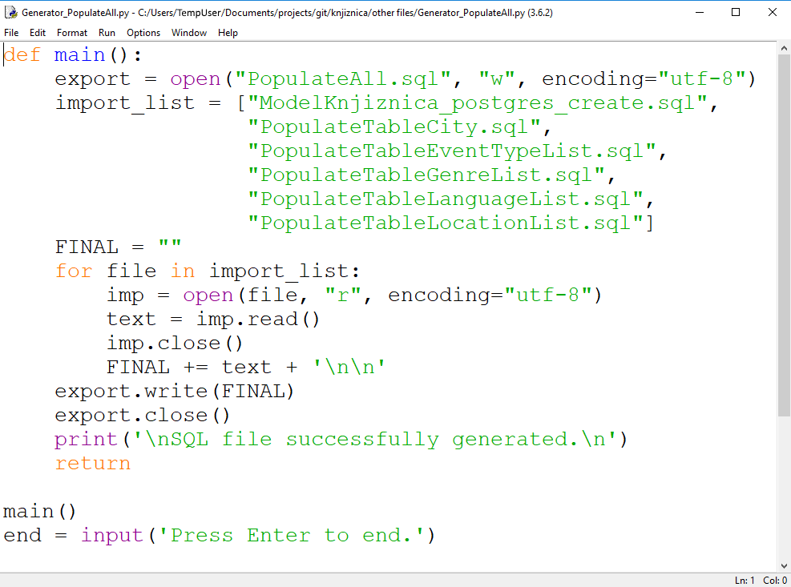
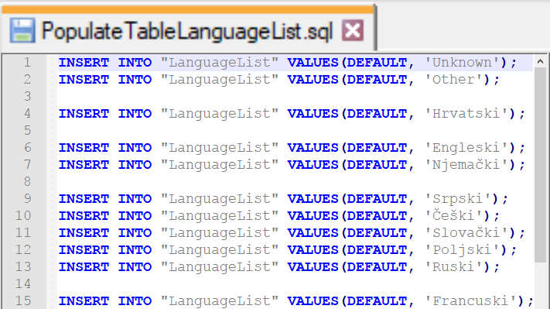
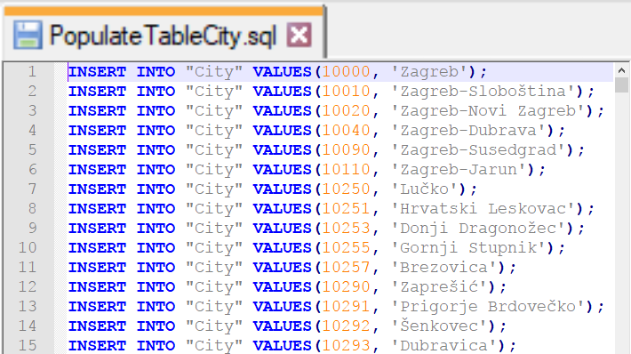
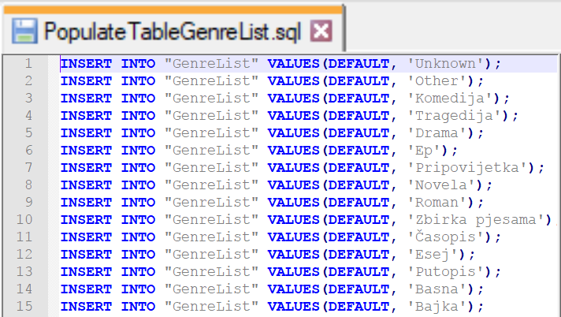
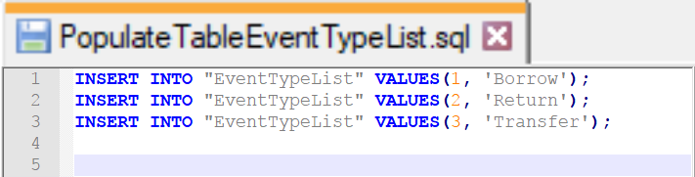
Baza podataka

Slide 12
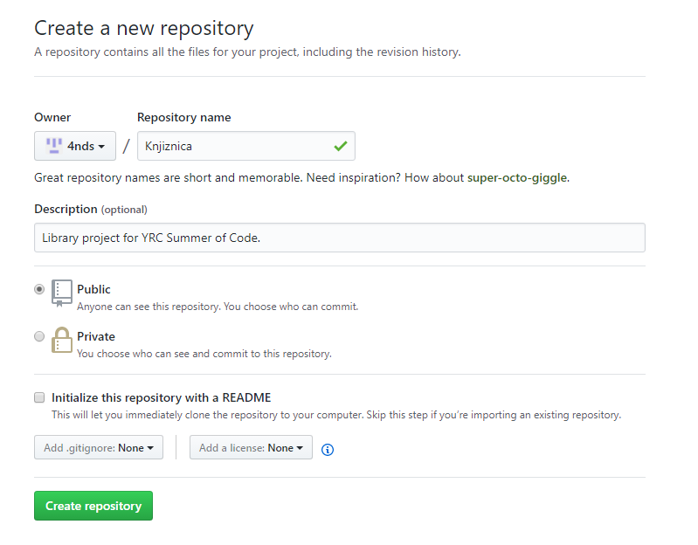
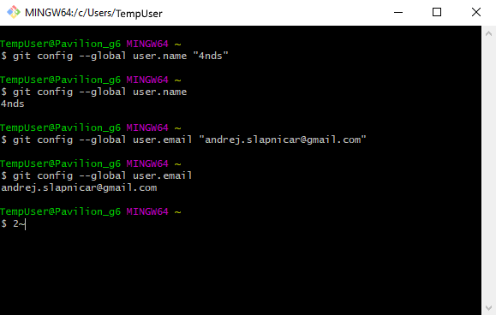
GitHub repozitorij
https://github.com/LVH-27/ellspace.git

Slide 13
Program u Javi
Klase classes
Metode methods
Statičke metode i varijable static methods and variables
Private/public metode i varijable private/public methods and variables
Singleton pattern
Dretve threads
Paketi packages
Izrada sučelja u Scene Builderu creating JavaFX GUI using Scene Builder
Povezivanje CSS-a i FXML-a connecting CSS and FXML with Java application
Upiti prema bazi podataka database queries

Slide 14

Izvori
Stack Overflow https://stackoverflow.com
Oracle Help Center https://docs.oracle.com
TutorialsPoint https://www.tutorialspoint.com/java
Ostali https://www.quora.com https://www.java2s.com https://help.github.com
Notes:
https://docs.oracle.com/javase/8/javafx/api/javafx/scene/Parent.htmlhttps://stackoverflow.com/questions/23666348/view-database-user-and-password-in-pgadminhttps://stackoverflow.com/questions/29262002/why-does-this-java-8-lambda-fail-to-compilehttps://www.java2s.com/Code/Java/JavaFX/AddingcomponentstoStackPane.htmhttps://docs.oracle.com/javase/7/docs/api/java/lang/Class.htmlhttps://gamedev.stackexchange.com/questions/72924/how-do-i-add-an-image-inside-a-rectangle-or-a-circle-in-javafxhttps://docs.oracle.com/javase/8/javafx/api/javafx/scene/Node.htmlhttps://stackoverflow.com/questions/6259339/how-to-read-a-text-file-directly-from-internet-using-javahttps://stackoverflow.com/questions/27894945/how-do-i-resize-an-imageview-image-in-javafxhttps://stackoverflow.com/questions/1759549/java-generics-multiple-generic-parametershttps://docs.oracle.com/javafx/2/api/javafx/scene/doc-files/cssref.htmlhttps://stackoverflow.com/questions/4464898/best-way-to-store-working-hours-and-query-it-efficientlyhttps://docs.oracle.com/javase/8/javafx/api/javafx/scene/control/Label.htmlhttps://docs.oracle.com/javafx/2/binding/jfxpub-binding.htmhttps://stackoverflow.com/questions/16287053/scene-getstylesheets-add-not-working-inside-jar-filehttps://grepcode.com/file/repo1.maven.org/maven2/net.java.openjfx.backport/openjfx-78-backport/1.8.0-ea-b96.1/javafx/scene/layout/BackgroundImage.javahttps://stackoverflow.com/questions/8706073/does-foreign-key-always-reference-to-a-unique-key-in-another-tablehttps://stackoverflow.com/questions/28656211/incompatible-types-bad-return-type-in-lambda-expressionhttps://stackoverflow.com/questions/11213079/javafx-2-borderpane-use-full-spacehttps://docs.oracle.com/javase/8/javafx/api/javafx/beans/value/class-use/ChangeListener.htmlhttps://stackoverflow.com/questions/12201712/how-to-find-an-element-with-an-id-in-javafxhttps://www.quora.com/How-do-I-set-size-of-a-image-inside-button-in-javafx-Is-it-possible-to-do-this-in-csshttps://docs.oracle.com/javase/8/javafx/api/javafx/scene/layout/Region.htmlhttps://stackoverflow.com/questions/1430836/eclipse-change-project-files-locationhttps://stackoverflow.com/questions/22692031/removing-object-from-scene-in-javafxhttps://www.tutorialspoint.com/java/java_basic_syntax.htmhttps://stackoverflow.com/questions/20014787/how-do-i-center-an-image-view-in-an-anchor-panehttps://docs.oracle.com/javase/8/docs/api/java/util/List.htmlhttps://docs.oracle.com/javase/8/javafx/api/javafx/scene/image/ImageView.htmlhttps://docs.oracle.com/javase/8/javafx/api/javafx/scene/Scene.htmlhttps://docs.oracle.com/javase/8/docs/api/java/io/File.htmlhttps://stackoverflow.com/questions/687833/how-to-get-the-last-value-of-an-arraylisthttps://stackoverflow.com/questions/37902660/javafx-button-sending-arguments-to-actionevent-functionhttps://stackoverflow.com/questions/35067893/how-do-i-get-an-element-in-javafx-using-an-idhttps://stackoverflow.com/questions/24096331/error-opening-scene-builderhttps://git-scm.com/book/id/v2/Git-Basics-Recording-Changes-to-the-Repositoryhttps://docs.oracle.com/javafx/2/css_tutorial/jfxpub-css_tutorial.htmhttps://docs.oracle.com/javase/8/javase-clienttechnologies.htmhttps://stackoverflow.com/questions/18682174/image-location-iside-borderpane-in-javafxhttps://grepcode.com/file/repo1.maven.org/maven2/net.java.openjfx.backport/openjfx-78-backport/1.8.0-ea-b96.1/javafx/scene/layout/BackgroundPosition.javahttps://stackoverflow.com/questions/16742521/reference-a-node-from-fxml-filehttps://stackoverflow.com/questions/16589988/binding-to-javafx-properties-of-an-object-that-can-be-switchedhttps://help.github.com/desktop/guides/contributing/adding-a-repository-from-your-local-computer-to-github-desktop/https://docs.oracle.com/javase/8/javafx/api/javafx/scene/Group.htmlhttps://stackoverflow.com/questions/1559440/combining-java-with-sqlhttps://docs.oracle.com/javase/8/javafx/api/javafx/scene/image/Image.htmlhttps://stackoverflow.com/questions/34463049/custom-control-classnotfoundexception-in-scene-builderhttps://stackoverflow.com/questions/12935953/javafx-class-controller-scene-referencehttps://help.github.com/articles/cloning-a-repository/https://stackoverflow.com/questions/13567802/javafx-getchildren-list-behaviourhttps://stackoverflow.com/questions/35556586/generics-theory-changelistener-changed-parameters-typehttps://stackoverflow.com/questions/1443210/updating-a-local-repository-with-changes-from-a-github-repositoryhttps://help.github.com/articles/adding-an-existing-project-to-github-using-the-command-line/https://forums.tutorialized.com/java-86/problem-with-javafx-2-0-set-background-image-385031.htmlhttps://stackoverflow.com/questions/27765401/creating-objects-and-adding-them-to-grouphttps://stackoverflow.com/questions/8360785/java-get-last-element-of-a-collectionhttps://netopyr.com/2012/02/02/creating-read-only-properties-in-javafx/https://docs.oracle.com/javase/8/javafx/api/javafx/collections/ObservableList.htmlhttps://docs.oracle.com/javase/8/docs/api/java/net/URL.htmlhttps://www.nomensa.com/blog/2010/4-rules-displaying-error-messages-user-experience-perspectivehttps://gist.github.com/zenideas/3810627https://stackoverflow.com/questions/26431840/javafx-borderpane-setcenter-replaces-entire-scenehttps://fxexperience.com/scenic-view/https://stackoverflow.com/questions/26811445/how-to-access-a-child-of-an-object-in-javafxhttps://dzone.com/articles/styling-javafx-control-csshttps://www.dummies.com/programming/java/javafx-binding-properties/https://stackoverflow.com/questions/21460742/javafx-remove-the-scene-loaded-in-center-of-borderpanehttps://docs.oracle.com/javase/8/javafx/api/javafx/scene/control/Button.htmlhttps://stackoverflow.com/questions/28558165/javafx-setvisible-doesnt-hide-the-elementhttps://stackoverflow.com/questions/1816673/how-do-i-check-if-a-file-exists-in-javahttps://stackoverflow.com/questions/6853877/reading-a-file-from-current-directory-in-javahttps://docs.oracle.com/javase/tutorial/jdbc/index.htmlhttps://docs.oracle.com/javase/8/javafx/api/javafx/scene/layout/StackPane.htmlhttps://www.caveofprogramming.com/java/java-static-class-tutorial.htmlhttps://stackoverflow.com/questions/352780/when-to-catch-java-lang-errorhttps://stackoverflow.com/questions/8798134/fatal-could-not-create-lock-file-postmaster-pid-permission-deniedhttps://www.dummies.com/programming/java/how-to-create-a-read-only-property-in-javafx/https://jojorabbitjavafxblog.wordpress.com/2011/09/03/javafx-2-0-css-styling-part-2/https://english.stackexchange.com/questions/32470/single-word-to-denote-date-and-timehttps://docs.oracle.com/javase/8/javafx/api/javafx/scene/layout/GridPane.htmlhttps://www.geeksforgeeks.org/static-class-in-java/https://docs.oracle.com/javase/8/javafx/api/javafx/beans/property/ReadOnlyDoubleWrapper.htmlhttps://docs.oracle.com/javase/8/javafx/api/javafx/scene/image/package-summary.htmlhttps://docs.oracle.com/javafx/2/scenegraph/jfxpub-scenegraph.htmhttps://stackoverflow.com/questions/30098116/javafx-css-button-with-image-how-to-define-the-size-of-the-imagehttps://docs.oracle.com/javase/8/javafx/api/javafx/scene/doc-files/cssref.htmlhttps://www.java2s.com/Code/Java/JavaFX/SetLabelTextcolor.htmhttps://stackoverflow.com/questions/34733972/changelistener-in-javafx-how-can-i-make-these-generics-parameters-less-uglyhttps://stackoverflow.com/questions/23494550/javafx-imageview-real-coordinates-translatex-and-translateyhttps://help.github.com/articles/adding-a-file-to-a-repository-using-the-command-line/https://gist.github.com/jewelsea/2556122

Slide 15
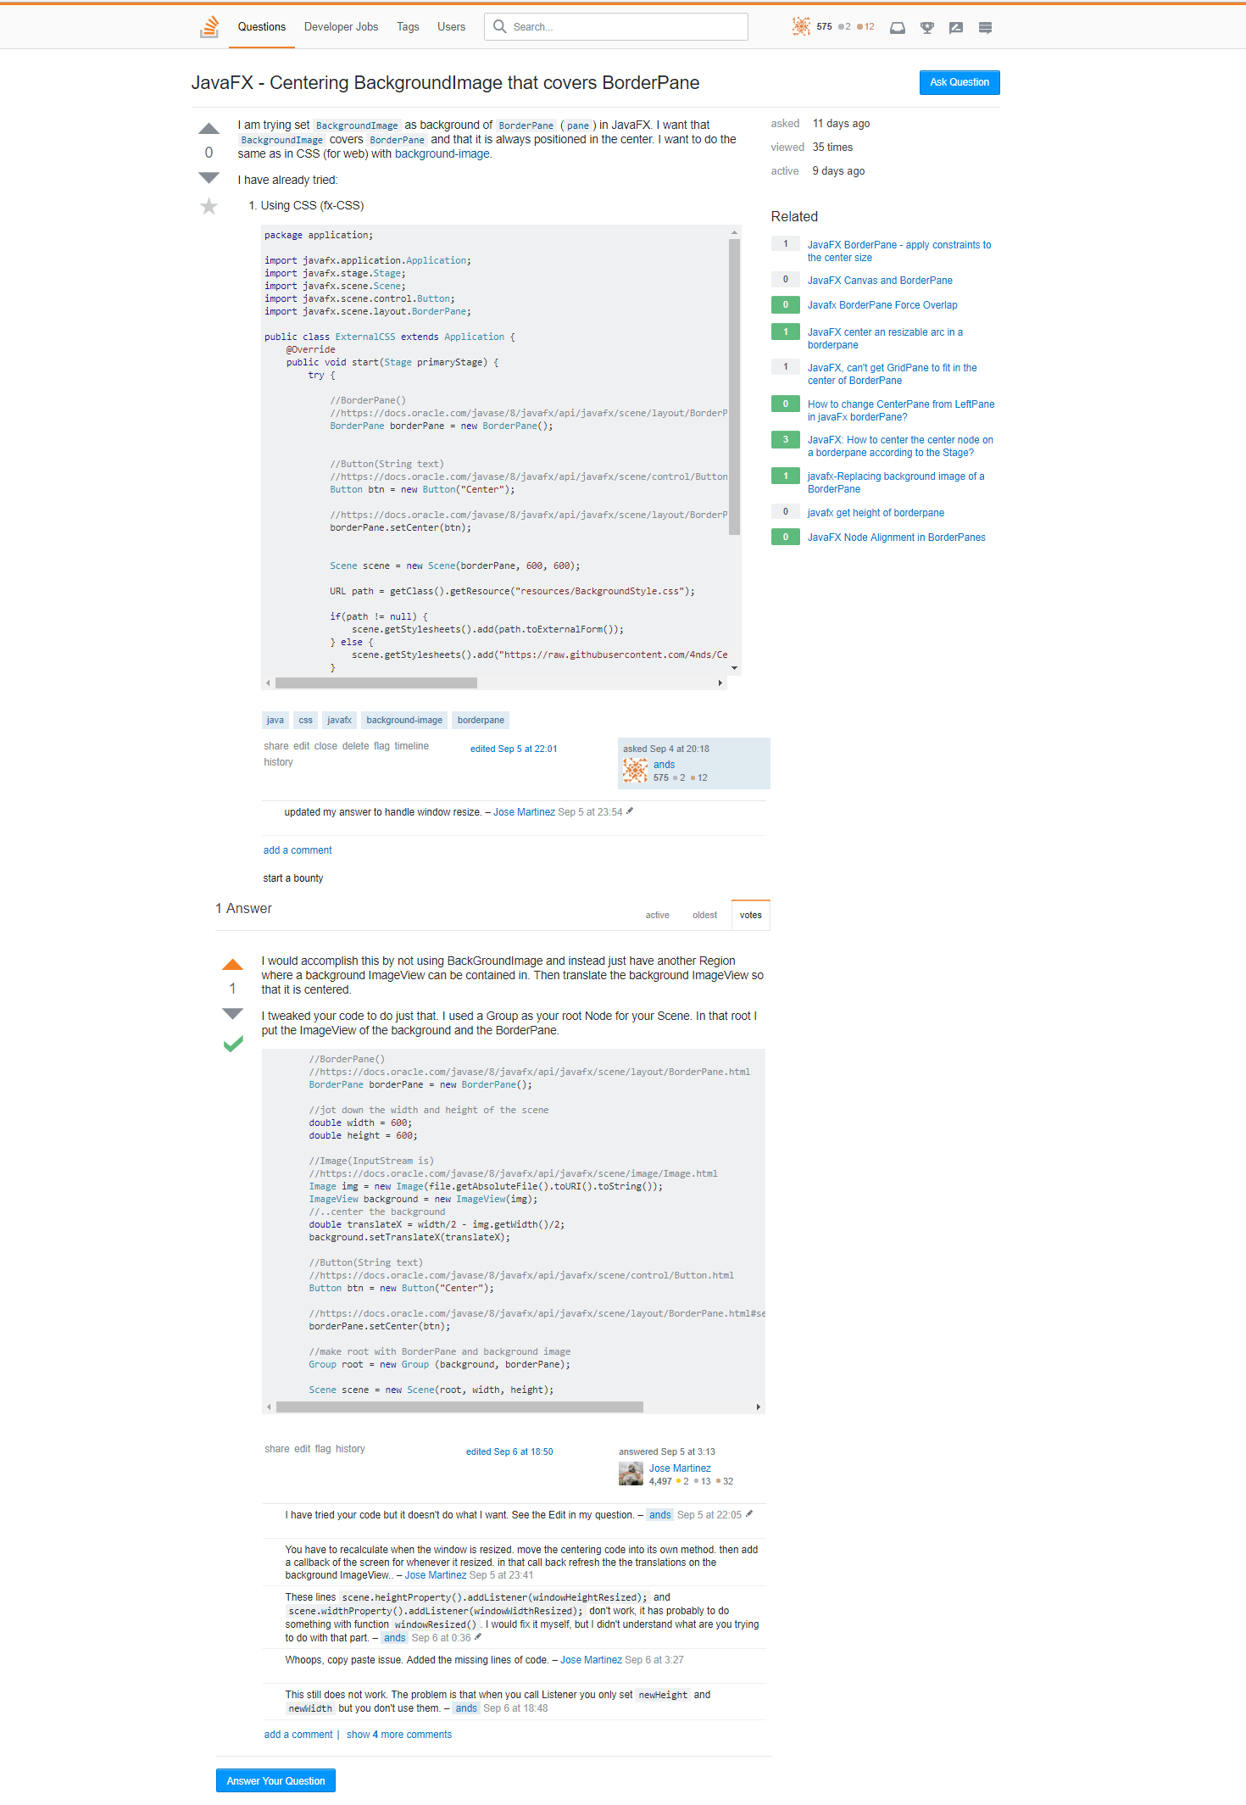
Background problem
https://stackoverflow.com/questions/46043562/javafx-centering-backgroundimage-that-covers-borderpane

Slide 16
Baza podataka
Reference i izvori
https://github.com/DevoKun/chocolatey-templates/blob/master/pgadmin3/pgadmin3.nuspec
https://raw.githubusercontent.com/DevoKun/chocolatey-templates/master/pgadmin3/pgadmin3_logo.png
https://dbdesigner.net/
https://dbdesigner.net/dbdesigner_logo_grid.png
http://www.eclipse.org/
http://www.eclipse.org/eclipse.org-common/themes/solstice/public/images/logo/eclipse-426x100.png
https://avaldes.com/jdbc-tutorials/
https://avaldes.com/wp-content/uploads/2014/11/Java.png
http://gluonhq.com/never-ending-popularity-scene-builder/
http://gluonhq.com/wp-content/uploads/2015/02/SceneBuilderLogo.png
http://www.automatedtesting.com/Product%20Roadmap.html
http://vannguyen.me/images/githubpurple.png
https://www.ostraining.com/classes/css/
https://www.ostraining.com/cdn/images/oscampus/courses/CSS-part-1.jpg
https://www.mikecann.co.uk/?s=javafx
https://mikecann.co.uk/wp-content/uploads/2009/12/javafx_logo_color_1.jpg
https://www.scrumdesk.com/slack-logo/
https://www.scrumdesk.com/wp-content/uploads/slack-logo-300x120.png
https://www.teamviewer.com/en/
http://forum.teamspeak.com/threads/68890-TeamSpeak-Logo
https://seeklogo.com/vector-logo/127795/skype
https://www.python.org/community/logos/
https://www.python.org/static/community_logos/python-logo-master-v3-TM.png
https://pixabay.com/en/photoshop-logo-symbol-adobe-icon-1065296/
https://cdn.pixabay.com/photo/2015/11/27/10/55/photoshop-1065296_960_720.jpg

Slide 17
Baza podataka
Reference i izvori
https://docs.oracle.com/javafx/2/binding/jfxpub-binding.htm
https://docs.oracle.com/javafx/2/css_tutorial/jfxpub-css_tutorial.htm
https://docs.oracle.com/javafx/2/scenegraph/jfxpub-scenegraph.htm
https://docs.oracle.com/javase/7/docs/api/java/lang/Class.html
https://docs.oracle.com/javase/8/javafx/api/javafx/beans/property/ReadOnlyDoubleWrapper.html
https://help.github.com/articles/adding-an-existing-project-to-github-using-the-command-line/
https://help.github.com/articles/cloning-a-repository/
https://help.github.com/desktop/guides/contributing/adding-a-repository-from-your-local-computer-to-github-desktop/
https://gist.github.com/jewelsea/2556122
https://stackoverflow.com/questions/12201712/how-to-find-an-element-with-an-id-in-javafx
https://stackoverflow.com/questions/16287053/scene-getstylesheets-add-not-working-inside-jar-file
https://stackoverflow.com/questions/16589988/binding-to-javafx-properties-of-an-object-that-can-be-switched
https://stackoverflow.com/questions/16742521/reference-a-node-from-fxml-file
https://stackoverflow.com/questions/1759549/java-generics-multiple-generic-parameters
https://stackoverflow.com/questions/1816673/how-do-i-check-if-a-file-exists-in-java
https://stackoverflow.com/questions/18682174/image-location-iside-borderpane-in-javafx
https://stackoverflow.com/questions/21460742/javafx-remove-the-scene-loaded-in-center-of-borderpane
https://stackoverflow.com/questions/23494550/javafx-imageview-real-coordinates-translatex-and-translatey
https://stackoverflow.com/questions/23666348/view-database-user-and-password-in-pgadmin
https://stackoverflow.com/questions/26431840/javafx-borderpane-setcenter-replaces-entire-scene
https://stackoverflow.com/questions/26811445/how-to-access-a-child-of-an-object-in-javafx
https://stackoverflow.com/questions/27894945/how-do-i-resize-an-imageview-image-in-javafx
https://stackoverflow.com/questions/30098116/javafx-css-button-with-image-how-to-define-the-size-of-the-image
https://stackoverflow.com/questions/35067893/how-do-i-get-an-element-in-javafx-using-an-id
https://stackoverflow.com/questions/352780/when-to-catch-java-lang-error
https://stackoverflow.com/questions/6259339/how-to-read-a-text-file-directly-from-internet-using-java
https://stackoverflow.com/questions/687833/how-to-get-the-last-value-of-an-arraylist
https://stackoverflow.com/questions/8706073/does-foreign-key-always-reference-to-a-unique-key-in-another-table
https://forums.tutorialized.com/java-86/problem-with-javafx-2-0-set-background-image-385031.html
https://fxexperience.com/scenic-view/
https://gamedev.stackexchange.com/questions/72924/how-do-i-add-an-image-inside-a-rectangle-or-a-circle-in-javafx
https://grepcode.com/file/repo1.maven.org/maven2/net.java.openjfx.backport/openjfx-78-backport/1.8.0-ea-b96.1/javafx/scene/layout/BackgroundImage.java
https://jojorabbitjavafxblog.wordpress.com/2011/09/03/javafx-2-0-css-styling-part-2/
https://www.geeksforgeeks.org/static-class-in-java/
https://www.java2s.com/Code/Java/JavaFX/SetLabelTextcolor.htm
https://www.quora.com/How-do-I-set-size-of-a-image-inside-button-in-javafx-Is-it-possible-to-do-this-in-css
https://www.tutorialspoint.com/java/java_basic_syntax.htm
https://stackoverflow.com/questions/46043562/javafx-centering-backgroundimage-that-covers-borderpane

Slide 18

Nastavak u Eclipsu…
Filip Husnjak
Luka Mesarić
Andrej Slapničar (Autor prezentacije)

